Slide 1
Number system, Operations and Basic Logic Gates
Part 1
Course : CPEN6265010 Digital System
Effective Period : September 2025

Slide 2
Related LO
Learning Objectives
LO1: Analyze and Design Combinational Logic Circuits.

Slide 3
Outlines
Decimal and Binary Numbers
Decimal-to-Binary Conversion
Binary Arithmetic
Complements of Binary Numbers
Signed Numbers

Slide 4
Decimal Numbers
The position of each digit in a weighted number system is assigned a weight based on the base or radix of the system. The radix of decimal numbers is ten, because only ten symbols (0 through 9) are used to represent any number.
The column weights of decimal numbers are powers of ten that increase from right to left beginning with 10⁰ =1:
…10⁵ 10⁴ 10³ 10² 10¹ 10⁰.
For fractional decimal numbers, the column weights are negative powers of ten that decrease from left to right:
10² 10¹ 10⁰. 10⁻¹ 10⁻² 10⁻³ 10⁻⁴ …

Slide 5
Decimal Numbers
Decimal numbers can be expressed as the sum of the products of each digit times the column value for that digit. Thus, the number 9240 can be expressed as
(9 x 10³) + (2 x 10²) + (4 x 10¹) + (0 x 10⁰)
or
9 x 1,000 + 2 x 100 + 4 x 10 + 0 x 1
Express the number 480.52 as the sum of values of each digit.
Example
Solution
480.52 = (4 x 10²) + (8 x 10¹) + (0 x 10⁰) + (5 x 10⁻¹) +(2 x 10⁻²)

Slide 6
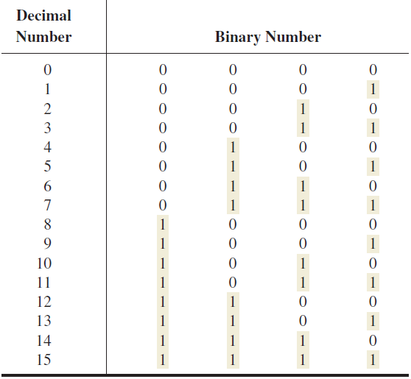
Binary Numbers
Largest decimal number = 2^{n} - 1
For example, with five bits (n = 5) you can count from zero to thirty-one.
2⁵ - 1 = 32 - 1 = 31

Slide 7
Binary Numbers
For digital systems, the binary number system is used. Binary has a radix of two and uses the digits 0 and 1 to represent quantities.
The column weights of binary numbers are powers of two that increase from right to left beginning with 2⁰ = 1:
…2⁵ 2⁴ 2³ 2² 2¹ 2⁰.
For fractional binary numbers, the column weights are negative powers of two that decrease from left to right:
2² 2¹ 2⁰. 2⁻¹ 2⁻² 2⁻³ 2⁻⁴ …

Slide 8

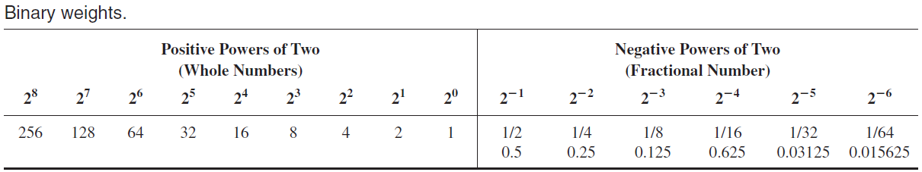
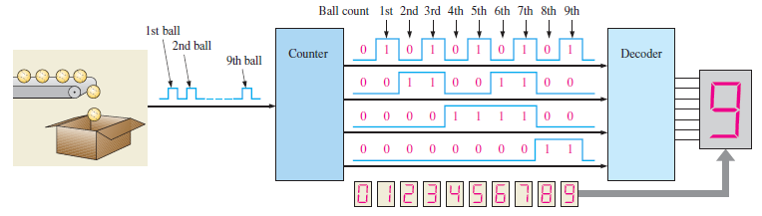
Binary Numbers
Illustration of a simple binary counting application.

Slide 9
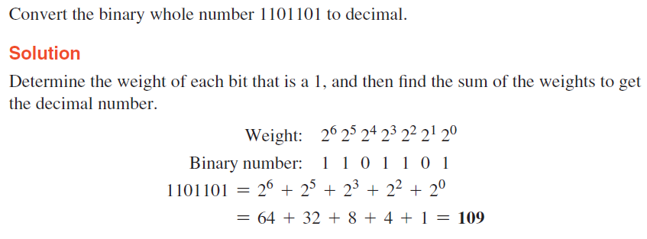
Binary Numbers
Decimal Number
Binary Number
A binary counting sequence for numbers from zero to fifteen is shown. Notice the pattern of zeros and ones in each column.
0 0 0 0 0
1 0 0 0 1
2 0 0 1 0
3 0 0 1 1
4 0 1 0 0
5 0 1 0 1
6 0 1 1 0
7 0 1 1 1
8 1 0 0 0
9 1 0 0 1
10 1 0 1 0
11 1 0 1 1
12 1 1 0 0
13 1 1 0 1
14 1 1 1 0
15 1 1 1 1
Example:

Slide 10
Decimal-to-Binary Conversion
You can convert a decimal whole number to binary by reversing the procedure. Write the decimal weight of each column and place 1’s in the columns that sum to the decimal number.
Convert the decimal number 49 to binary using sum-of-weights method.
Example
The column weights double in each position to the right. Write down column weights until the last number is larger than the one you want to convert.
Solution
2⁶ 2⁵ 2⁴ 2³ 2² 2¹ 2⁰.
64 32 16 8 4 2 1.
0 1 1 0 0 0 1.

Slide 11
Decimal-to-Binary Conversion
You can convert decimal to any other base by repeatedly dividing by the base. For binary, repeatedly divide by 2:
Example
Convert the decimal number 49 to binary by repeatedly dividing by 2.
Solution
You can do this by “reverse division” and the answer will read from left to right. Put quotients to the left and remainders on top.
Answer:
1
1
0
0
0
1
remainder
0
1
3
6
12
24
49 2
Continue until the last quotient is 0
Decimal number
base
Quotient

Slide 12
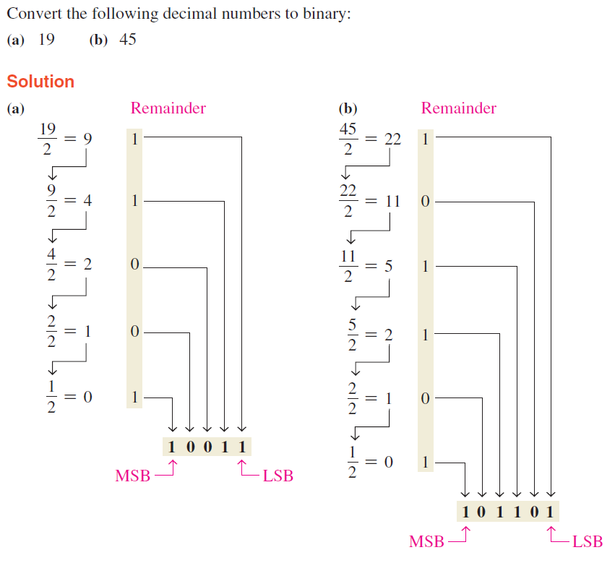
Decimal-to-Binary Conversion

Slide 13
Decimal-to-Binary Conversion
You can convert a decimal fraction to binary by repeatedly multiplying the fractional results of successive multiplications by 2. The carries form the binary number.
Example
Convert the decimal fraction 0.188 to binary by repeatedly multiplying the fractional results by 2.
Solution
0.188 x 2 = 0.376 carry = 0
MSB
0.376 x 2 = 0.752 carry = 0
0.752 x 2 = 1.504 carry = 1
0.504 x 2 = 1.008 carry = 1
0.008 x 2 = 0.016 carry = 0
Answer = .00110 (for five significant digits)

Slide 14
Binary Arithmetic - Addition
The rules for binary addition are
0 + 0 = 0 Sum = 0, carry = 0
0 + 1 = 0 Sum = 1, carry = 0
1 + 0 = 0 Sum = 1, carry = 0
1 + 1 = 10 Sum = 0, carry = 1
When an input carry = 1 due to a previous result, the rules are
1 + 0 + 0 = 01 Sum = 1, carry = 0
1 + 0 + 1 = 10 Sum = 0, carry = 1
1 + 1 + 0 = 10 Sum = 0, carry = 1
1 + 1 + 1 = 10 Sum = 1, carry = 1

Slide 15
Binary Arithmetic - Addition
Example
Add the binary numbers 00111 and 10101 and show the equivalent decimal addition.
Solution
0
1
1
1
00111 7
10101 21
1
1
1
0
0
=
28

Slide 16
Binary Arithmetic - Subtraction
The rules for binary subtraction are
0 - 0 = 0
1 - 1 = 0
1 - 0 = 1
10 - 1 = 1 with a borrow of 1
Example
Subtract the binary number 00111 from 10101 and show the equivalent decimal subtraction.
Solution
/¹
/¹
/¹
10101 21
00111 7
0
1
1
1
0
=
14

Slide 17
Complements of Binary Numbers
The 1’s complement of a binary number is just the inverse of the digits. To form the 1’s complement, change all 0’s to 1’s and all 1’s to 0’s.
For example, the 1’s complement of 11001010 is
00110101
In digital circuits, the 1’s complement is formed by using inverters:
1 1 0 0 1 0 1 0
0 0 1 1 0 1 0 1

Slide 18
Complements of Binary Numbers
The 2’s complement of a binary number is found by adding 1 to the LSB of the 1’s complement.
Recall that the 1’s complement of 11001010 is
00110101 (1’s complement)
To form the 2’s complement, add 1:
+1
00110110 (2’s complement)
1 1 0 0 1 0 1 0
1
0 0 1 1 0 1 0 1
0 0 1 1 0 1 1 0

Slide 19
Signed Numbers
There are several ways to represent signed binary numbers. In all cases, the MSB in a signed number is the sign bit, that tells you if the number is positive or negative.
Computers use a modified 2’s complement for signed numbers. Positive numbers are stored in true form (with a 0 for the sign bit) and negative numbers are stored in complement form (with a 1 for the sign bit).
For example, the positive number 58 is written using 8-bits as 00111010 (true form).
Sign bit
Magnitude bits

Slide 20
Signed Numbers
Negative numbers are written as the 2’s complement of the corresponding positive number.
The negative number −58 is written as:
−58 = 11000110 (complement form)
Sign bit
Magnitude bits
An easy way to read a signed number that uses this notation is to assign the sign bit a column weight of −128 (for an 8-bit number). Then add the column weights for the 1’s.
Example
Assuming that the sign bit = -128, show that 11000110 = -58 as a 2’s complement signed number:
Solution
Column weights: -128 64 32 16 8 4 2 1.
1 1 0 0 0 1 1 0
-128 +64 +4 +2 = -58

Slide 21
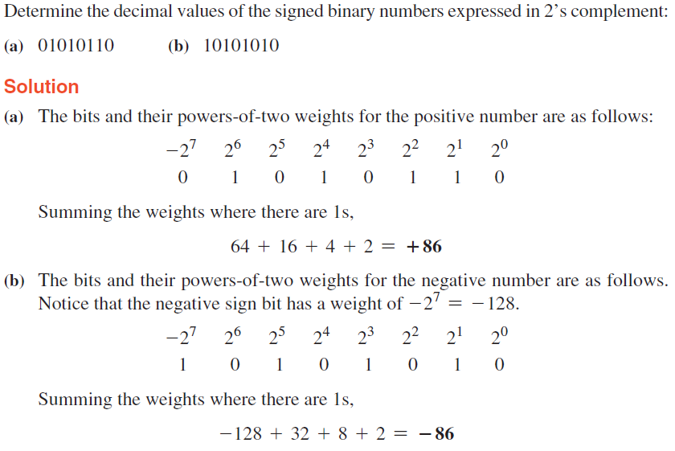
Signed Numbers

Slide 22
Exercise
What is the weight of 7 in each of the following decimal numbers?
(a) 1947 (b) 1799 (c) 1979
Express each of the following decimal numbers as a power of ten:
(a) 1000 (b) 10000000 (c) 1000000000
Convert each decimal fraction to binary using the sum-of-weights method:
(a) 0.26 (b) 0.762 (c) 0.0975
How is zero represented in 2’s complement form?
Perform each addition in the 2’s complement form:
  (a) 00010110 + 00110011 (b) 01110000 + 10101111
Convert each binary number to hexadecimal:
(a) 1111 (b) 1011 (c) 11111
Convert each pair of decimal numbers to BCD, and add as indicated:
(a) 28 + 23 (b) 65 + 58 (c) 113 + 101

Slide 23
References
M. Morris Mano and Michael Ciletti. (2017). Digital Design: With an Introduction to the Verilog HDL, VHDL, and SystemVerilog 6th Edition. Pearson Education. New Jersey. ISBN: 9780134549897.
Thomas L. Floyd. (2014). Digital Fundamentals. 11. Prentice Hall. New Jersey. ISBN: 978-0132737968.
Number System tutorial: https://ryanstutorials.net/binary-tutorial/
Binary Numbers Explained – Beginners Guide: http://www.steves-internet-guide.com/binary-numbers-explained/

Slide 24
References
Null, Linda (2024). "The essentials of computer organization and architecture". 6th edition. Jones & Bartlett Learning, Burlington, Massachusetts. ISBN: 9781284259438..
Thomas L. Floyd. (2014). “Digital Fundamentals”. 11th Edition. Prentice Hall. New Jersey. ISBN: 978-0132737968.
Digital Logic Gates: https://www.electronics-tutorials.ws/logic/logic_1.html
CMOS and TTL Comparisons: https://circuitdigest.com/article/comparision-between-cmos-vs-ttl-logic-which-is-better-and-why

